Slide 1
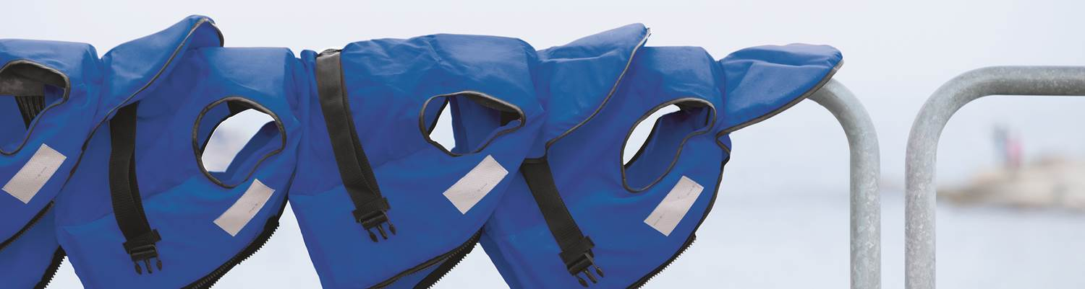
Titanic Exercise
Peter Cvacho, Pricing Data Analyst EUBA - Bratislava 2017-04-06
General Insurance

Slide 2
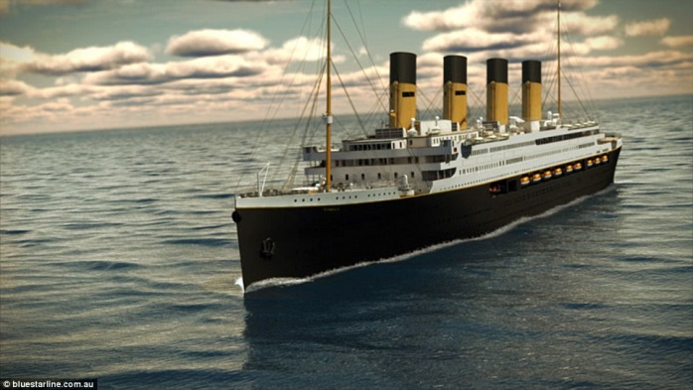
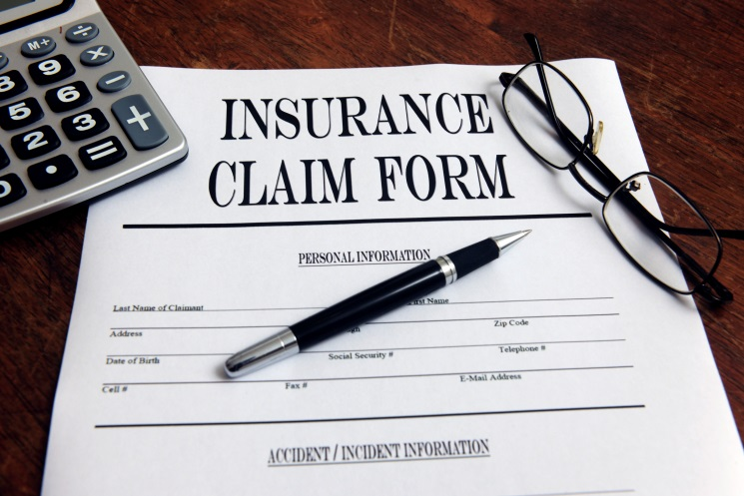
Case Intro
Company Titanic s. r. o.
Business Task:
Underwriting department asked you about to help with pricing new product for marine line of business.
--------------------------------------------------------------------
Our Goal:
We want to know, what is the risk, passengers are facing during the trip and what should be sustainable price in case of accident.
--------------------------------------------------------------------
Some Facts:
Company owns ship and they provide intercontinental trips.
They had several crashes in the past.
Data about 9891 passengers from 11 trips.

Slide 3
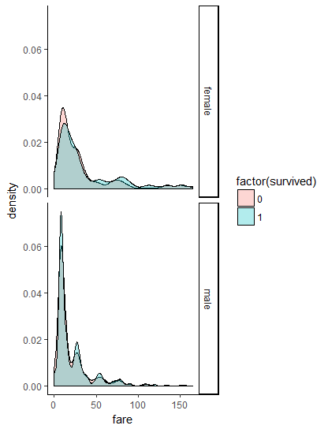
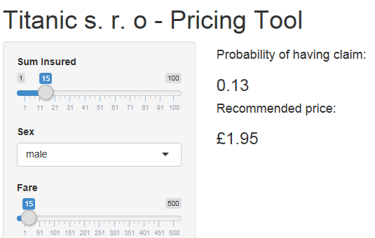
Case Exploration
Statistics might help!
Our Goal:
We want to know, what is the risk, passengers are facing during the trip and what should be sustainable price in case of accident.

Slide 4
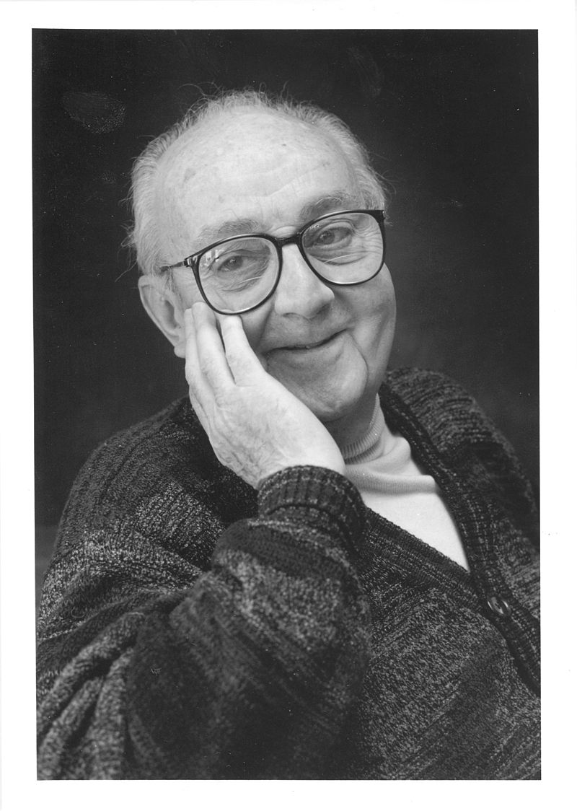
Solution
Generalized Linear Models
George E. P. Box:
“Essentially, all models are wrong,
but some of them are useful”
So, Why GLM?
Because we can*.
*if assumptions of GLM are satisfied

Slide 5





Solution
Generalized Linear Models
9891 passengers
Having (0) / Not having (1) Claim
Features: Sex, Age, …
Binomial Distribution
in Regression
Def.:
Link Function:
Mean Function:

Slide 6
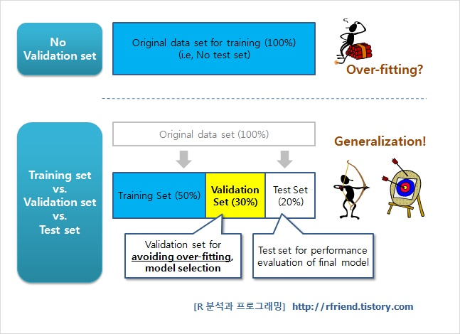
Modeling
Training vs. Validation
We will use rule of 70:20:10

Slide 7

Modeling
Exercise
Our Goal:
We want to know, what is the risk, passengers are facing during the trip and what should be sustainable price in case of accident.
Improve Current Model
How?
Add New Features
Capping
Grouping Continuous Feature
Normalization
Etc.
glm(data = train_70,
formula = survived ~ sex + age,
family = binomial())

Slide 8
Modeling
Exercise
Our Goal:
We want to know, what is the risk, passengers are facing during the trip and what should be sustainable price in case of accident.
How?
Add New Features
Capping
Grouping Continuous Feature
Normalization
Etc.
# VARIABLE DESCRIPTIONS:
# survival Claim Status
# (0 = Having a Claim; 1 = Not Having a Claim)
# pclass Passenger Class
# (1 = 1st; 2 = 2nd; 3 = 3rd)
# sex Sex
# age Age
# sibsp Number of Siblings/Spouses Aboard
# parch Number of Parents/Children Aboard
# fare Passenger Fare
# embarked Port of Embarkation
# ship Company ship number

Slide 9
Cheatsheet
Base R
http://github.com/rstudio/cheatsheets/raw/master/source/pdfs/base-r.pdf

Slide 10


Slide 11
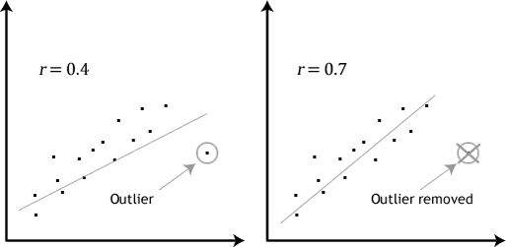
Modeling
Outliers

Slide 12
Summary
What have you learnt today?
Training vs. Validation
Checking of missing values and its imputation
Identifying outliers and capping them

Slide 13
Materials
Many Cheatsheets https://www.rstudio.com/resources/cheatsheets/
More about Shiny (gallery, tutorials, articles, …) https://shiny.rstudio.com/
R Programming http://www.cookbook-r.com/
GLM Paper https://www.jstor.org/stable/2344614?seq=1#page_scan_tab_contents

Slide 14

https://www.surveymonkey.co.uk/r/L9DTD9D

